Slide 1
LIBRARY MANAGEMENT SYSTEM
Elaboration(iteration 2)
Week 6 - 8

Slide 2
contents
Remaining use cases(70%)
Design class diagrams
UI prototype
Updated risk and mitigation

Slide 3
Use case 6: Search for a book
Actors: Member, Librarian
Description: Allows users to search for books by title, author, genre, or ISBN to locate desired items in the catalog.
Preconditions: The book catalog is available and system is online.
Postconditions: A list of matching books is displayed with relevant details (e.g., availability).
Main Flow:
User enters search criteria (title, author, genre, ISBN).
System queries the book catalog.
System returns matching results with availability status.
User views search results.
Alternative Flow:
No matching book found “No results for the desired book”

Slide 4
Use Case 7: Categorize Books
Actors: Librarian
Description: Enables librarians or admins to organize books by genre or subject for easier browsing and searching.
Preconditions: Librarian/Admin is logged in and has access to book management functions.
Postconditions: Books are categorized and stored in the system with updated metadata.
Main Flow:
Librarian selects a book from the catalog.
Librarian chooses or creates a category (e.g., genre).
System assigns the book to the selected category.
Confirmation is shown to the librarian.
Alternative Flow:
Invalid category.

Slide 5
Use Case 8: View Book Details
Actors: Member, Librarian, Admin
Description: Displays complete details of a book, including summary, author, availability, and user reviews.
Preconditions: Book exists in the catalog.
Postconditions: Book details are retrieved and displayed to the user.
Main Flow:
User selects a book from search results or catalog.
System retrieves details and reviews.
System displays detailed view of the book.

Slide 6
Use Case 9: Renew Book Loan
Actors: Member, Librarian
Description: Allows users to extend the due date of an active book loan if renewal conditions are met (e.g., no reservations).
Preconditions: User is logged in and has an active loan.
Postconditions: Loan due date is updated in the system.
Main Flow:
User selects the loan to renew.
System checks eligibility (e.g., not overdue, no reservations).
If eligible, system extends the due date.
System confirms renewal to the user.
Alternative Flow:
Loan cannot be renewed

Slide 7
Use Case 10: Check Overdue Books
Actors: Librarian, System (automated)
Description: Identifies books that are overdue and flags them for follow-up or fines.
Preconditions: Active loans exist in the system.
Postconditions: Overdue books are marked and notifications/fines can be triggered.
Main Flow:
System scans active loans for overdue dates.
System generates a list of overdue books.
Librarian views or acts upon overdue list

Slide 8
Use Case 11: View Member Information
Actors: Librarian, Admin
Description: Provides a detailed view of a member’s account, including borrowing history, active loans, and outstanding fines.
Preconditions: Member record exists.
Postconditions: Information is retrieved and displayed.
Main Flow:
Librarian searches for a member.
System retrieves and displays member information

Slide 9
Use Case 12: Send Notifications
Actors: System (automated), Librarian
Description: Sends reminders for due dates, overdue books, and reservation availability via email or SMS.
Preconditions: Member contact details are available and notification system is active.
Postconditions: Notifications are sent to targeted members.
Main Flow:
System identifies triggers (e.g., due date approaching).
System composes and sends notification.
Member receives reminder.

Slide 10
Use Case 13: Manage Fines and Payments
Actors: Member, Librarian
Description: Calculates fines for overdue books, displays outstanding balances, and processes payments.
Preconditions: Overdue loans exist; payment methods are configured.
Postconditions: Fine is recorded as paid or outstanding balance updated.
Main Flow:
System calculates fine amount for overdue loans.
Member views outstanding fines.
Member makes payment; system records transaction.

Slide 11
Use Case 14: Member Login and Registration
Actors: Visitor, Member
Description: Allows visitors to register for membership and existing members to log in for personalized features.
Preconditions: Visitor is not already registered.
Postconditions: New member record created, or user authenticated.
Main Flow:
Visitor opens registration/login page.
Visitor enters credentials or registration details.
System validates and creates/authenticates account.
Member gains access to personalized services.

Slide 12
Use Case 15: Reservation of Books
Actors: Member
Description: Allows users to reserve books currently borrowed by others.
Preconditions: Book is not available; user is logged in.
Postconditions: Reservation is stored and user is notified when book is available.
Main Flow:
User selects unavailable book.
System records reservation.
System notifies user when book becomes available.

Slide 13
Use Case: Loan Book
Actors: Member, Librarian
Description: Member borrows an available book; system records loan and sets due date.
Preconditions: Member is registered and logged in; book is available.
Postconditions: Loan record created; book marked as “On Loan.”
Main Flow:
Member selects book to borrow.
System checks availability and member eligibility.
Loan is recorded with due date; book status updated.
Confirmation displayed to member.
Alternative Flows:
book unavailable
Ineligible to borrow a book

Slide 14
Use Case 16: Authentication and Authorization
Actors: Member, Librarian, System
Description: Ensures that users can only access features based on their roles (member, librarian, admin).
Preconditions: User is logged in.
Postconditions: Access control is enforced according to role.
Main Flow:
System verifies login credentials.
System checks assigned role.
System grants or restricts access to specific functions

Slide 15
Design class Diagrams

Slide 16
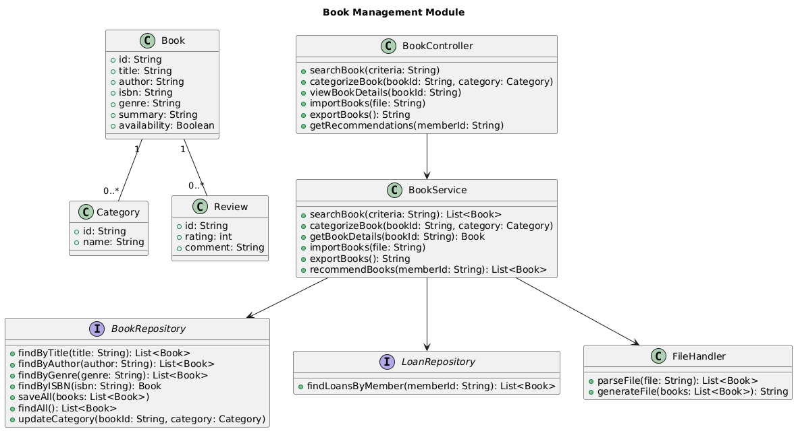
Book Management Module

Slide 17
Domain Classes: Book, Category, and Review. These represent the core data entities, with Book having a one-to-many relationship with both Category and Review.
Service Layer: The BookService class contains the business logic for managing books. It has methods for searching, categorizing, importing/exporting books, and getting recommendations.
Presentation Layer: The BookController class handles user requests related to book management. It has methods that correspond to the actions a user might take, such as searchBook and getRecommendations.
Data Access Layer: The BookRepository interface defines methods for data persistence and retrieval, like findByTitle and saveAll. The FileHandler interface handles file-specific operations like parsing and generating files.

Slide 18
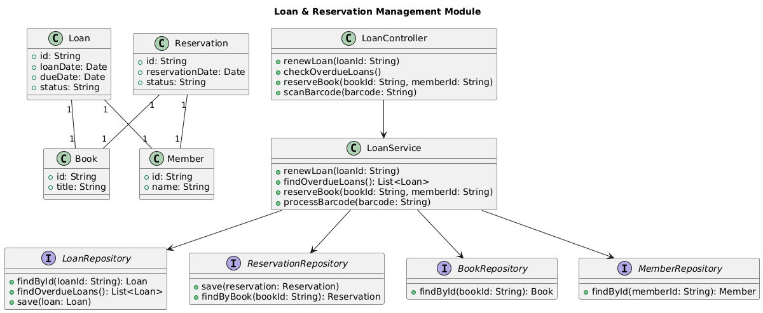
Loan & Reservation Management Module

Slide 19
Loan & Reservation Management Module
This module handles the processes of borrowing, returning, and reserving books.
Domain Classes: Loan, Reservation, Book, and Member. These classes model the core interactions of the loan system. A Book can have multiple Loan and Reservation objects, and a Member can also have multiple loans and reservations.
Service Layer: The LoanService class orchestrates the business logic for loans and reservations. It includes methods like renewLoan, checkOverdueLoans, and reserveBook.
Presentation Layer: The LoanController manages user interactions related to loans, with methods for renewing loans and checking for overdue books.
Data Access Layer: This module uses several repository interfaces: LoanRepository, ReservationRepository, BookRepository, and MemberRepository. This separation of concerns allows the service to interact with different data sources without being tightly coupled to their implementation.

Slide 20
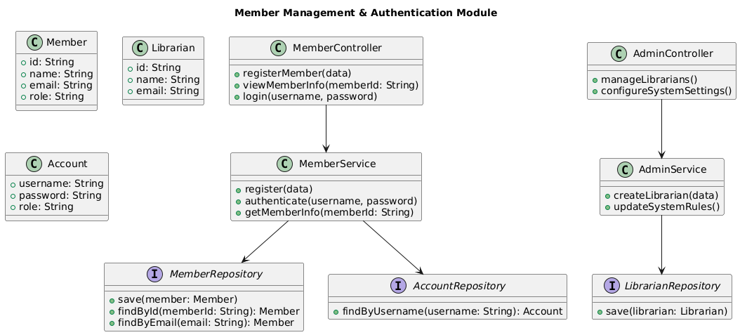
Member Management & Authentication Module

Slide 21
This diagram outlines how user accounts and member information are managed.
Domain Classes: Member, Librarian, and Account. The Member and Librarian classes seem to be specialized types of users, while Account holds authentication details like username, password, and role.
Service Layer: The MemberService handles user-related business logic, such as register and authenticate. The AdminService contains methods for administrative tasks, like createLibrarian and updateSystemRules.
Presentation Layer: The MemberController and AdminController classes are responsible for handling user and administrator requests, respectively.
Data Access Layer: The module relies on MemberRepository, AccountRepository, and LibrarianRepository interfaces to manage data for each of these domain classes.

Slide 22
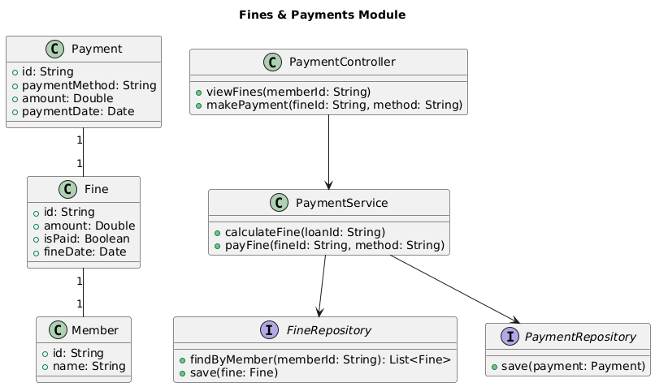
Fines & Payments Module

Slide 23
This module models the processes for calculating and managing fines and payments.
Domain Classes: Payment, Fine, and Member. A Member can have multiple Fine objects, and each Fine can be associated with a Payment.
Service Layer: The PaymentService contains the business logic for fines and payments, including methods to calculateFine and payFine.
Presentation Layer: The PaymentController handles user-facing fine and payment-related actions, such as viewFines and makePayment.
Data Access Layer: The FineRepository and PaymentRepository interfaces are used to manage the data for fines and payments, respectively.

